Slide 1
Heart Disease Prediction System

Slide 2
Literature Review: Heart Disease Prediction System using Machine Learning
Several investigations have delved into employing machine learning for heart disease prediction. Shuge Ouyang (2022)[1] and Chua, S.(2022)[2] each devised systems utilizing various algorithms; Shuge Ouyang concentrated on Support Vector Machine and decision trees, while Chua, S. explored Naïve Bayes, K-Nearest Neighbor, Support Vector Machine, Random Forest, and Decision Tree. Shah, W.(2021)[3] established a dependable prediction system using the Random Forest algorithm, whereas Yadav (2021)[4] achieved a remarkable 96% accuracy through the application of a genetic algorithm for feature optimization in the Naïve Bayes model. Collectively, these studies underscore the potential of machine learning In accurately forecasting heart disease.
Developing systems to predict heart disease is a major focus of research. Scientists are using patient records and various computer programs to improve the accuracy of these predictions. However, there are challenges with these systems. L. P. Koyi (2021)[13] discusses issues like how to describe the information, identifying risk factors, and establishing connections between them. Rahman (2022)[14] emphasizes the importance of fast and accurate predictions. They used computer programs to achieve high accuracy and explored different ways to organize information. Despite progress, there are still problems with the quality of information, understanding it, and making it beneficial for everyone. More research is necessary to address these challenges.

Slide 3
Phase 1: Data Preprocessing, Exploration & Visualization Phase 2: Implementing Machine Learning on the processed Data

Slide 4
Introduction
Source of Dataset
The dataset employed in this research, obtained from Kaggle (fedsoriano, September 2021), focuses on predicting heart failure and includes data concerning occurrences of heart failure as well as related factors. It serves as a valuable resource for conducting analyses and investigations within the field of cardiovascular health.
Details of the dataset
The dataset centers on heart diseases, which stand as the primary cause of death globally, accounting for roughly 17.9 million deaths each year, equivalent to around 31% of total global fatalities. Heart failure is common and frequently linked with heart diseases. This dataset consists of 11 features and 918 observation designed to forecast potential heart issues. Early identification and control are crucial, especially for individuals afflicted with heart diseases or those facing heightened risk.

Slide 5
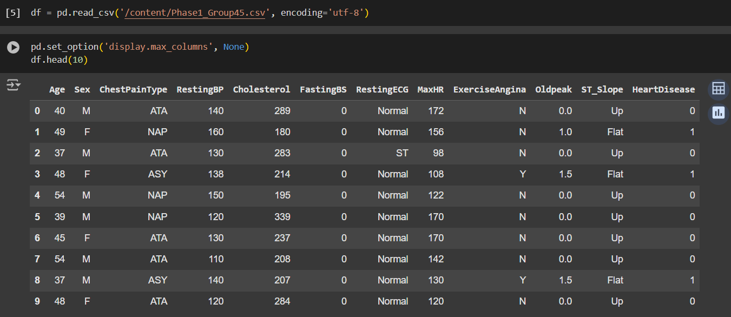
Reading the dataset and displaying the top 10 rows

Slide 6
Goals and Objectives
Detecting heart disease early is crucial for better patient outcomes, making it an important focus in public health.
The main aim of this project has two parts: first, to forecast the chance of heart disease using common health markers, and second, to pinpoint the key factors that contribute to the occurrence of heart disease. Using machine learning methods, the goal is to thoroughly examine patient data to gain a deeper understanding of the factors linked to the development of heart disease.
Furthermore, a secondary goal is to perform exploratory data analysis (EDA) to reveal patterns and connections within the dataset. This step entails using fundamental descriptive statistics and visualizations to understand the underlying factors contributing to heart disease risk. Data cleaning and preprocessing are crucial steps in this process to maintain the accuracy and dependability of the ensuing predictive modeling.
In conclusion, the objectives established in this project address the pressing need for accurate and dependable predictive models in cardiovascular health. By employing data-driven methods and robust methodologies, this initiative strives to progress early detection, refine clinical decision-making, and ultimately contribute to better patient outcomes in preventing and managing heart disease.

Slide 7
Data Cleaning and Preprocessing
In this part, we explain the actions we took to clean and prepare the data for this project.
Initial Data Exploration:
We began by examining the dataset's information using df.info() to get an overview of the data types and presence of missing values. Subsequently, we utilized df.describe() to generate descriptive statistics, aiding in understanding the distribution and range of values within each column.
2. Handling Duplicate and Null Values:
To ensure data integrity, we checked for any duplicate entries or null values within the dataset. By employing techniques such as df.duplicated() and df.isnull().sum(), we identified and addressed any duplicate rows or missing values.
3. Removal of Zero Values:
Upon further inspection, we discovered certain columns containing zero values, which could potentially affect model performance. To mitigate this, we systematically removed zero values from these specific columns, ensuring the reliability and accuracy of the dataset for subsequent modeling tasks.

Slide 8
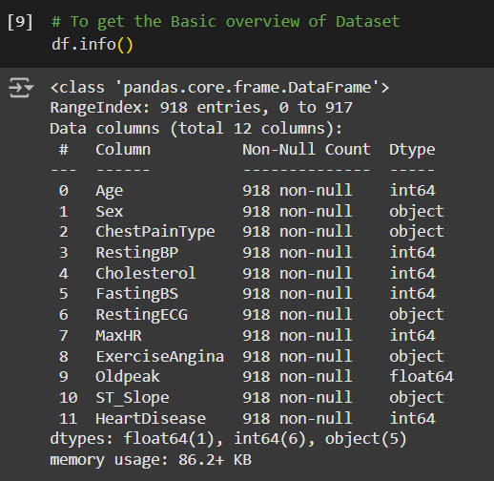
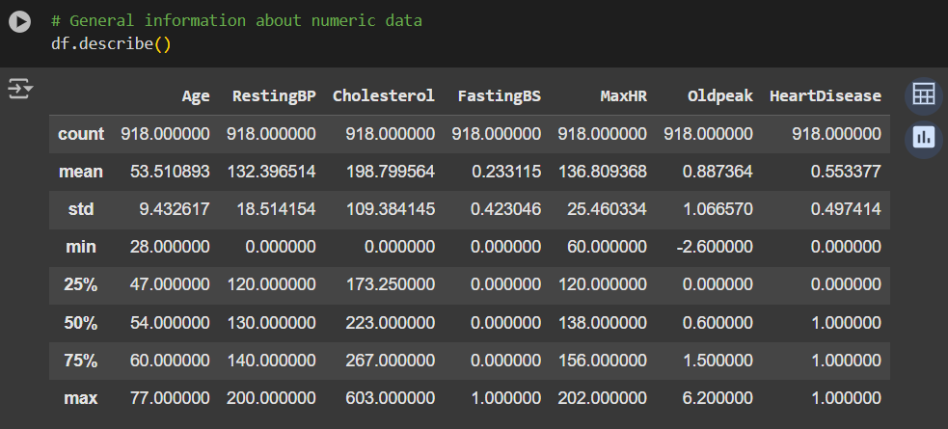
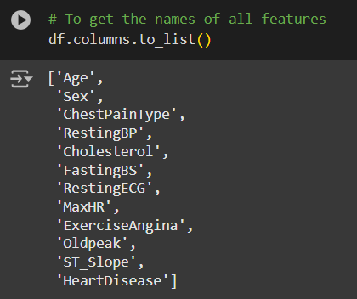
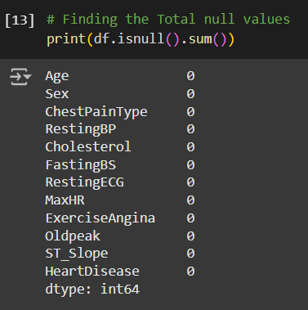
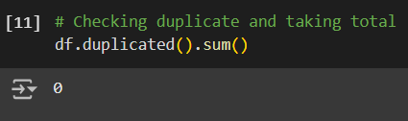

Slide 9
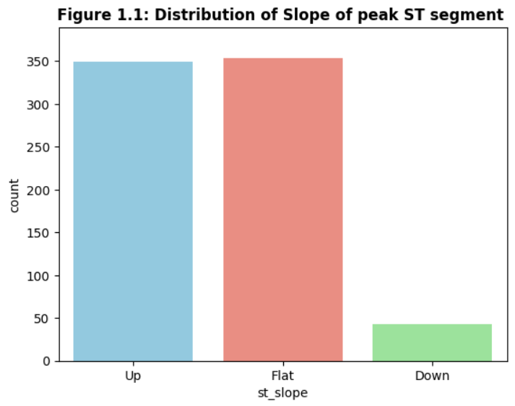
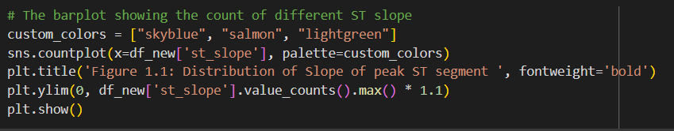
Data Exploration & Visualization With our dataset now deemed clean, we're prepared to commence visualizing and exploring each of its features.
Univariate Visualization
Bar plot of peak of ST slope segment
The figure 1.1 is countplot which shows the frequency of each ST slope type using different colors for better visualization. As we can see from the figure 1.1 Flat slope is the max count in the dataset.

Slide 10
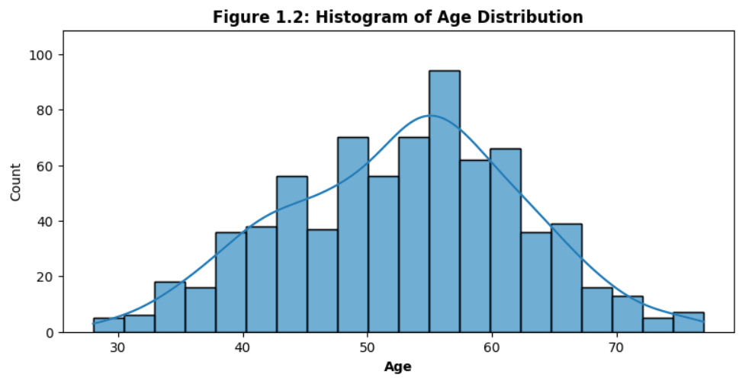
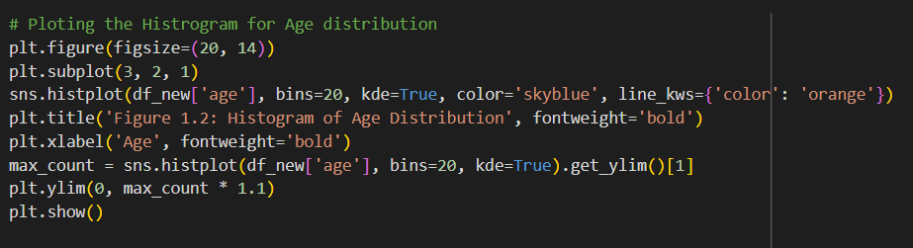
Histrogram of Age
The figure 1.2 is the histogram illustrating the distribution of ages within the dataset. Each bar represents the frequency (count) of individuals falling within a specific age range.

Slide 11
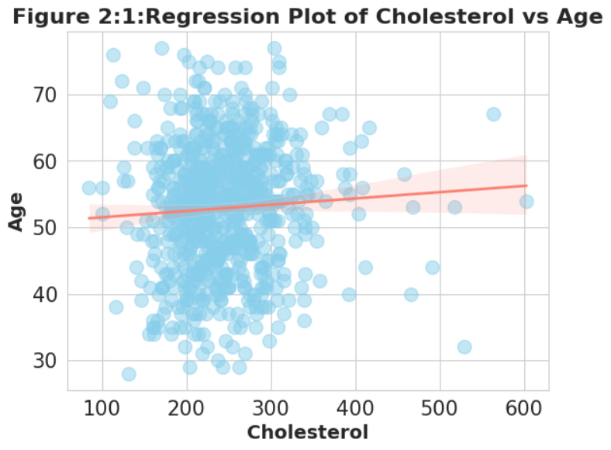
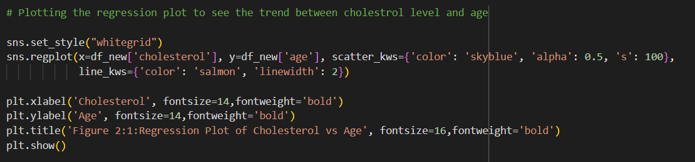
Two-Variable Visualization Regression plot between Cholesterol and Age
Figure 2.1 is a regression plot illustrating the relationship between cholesterol levels and age. Each data point represents an individual's cholesterol level and age. The plot includes a regression line, which shows the overall trend in the data.

Slide 12
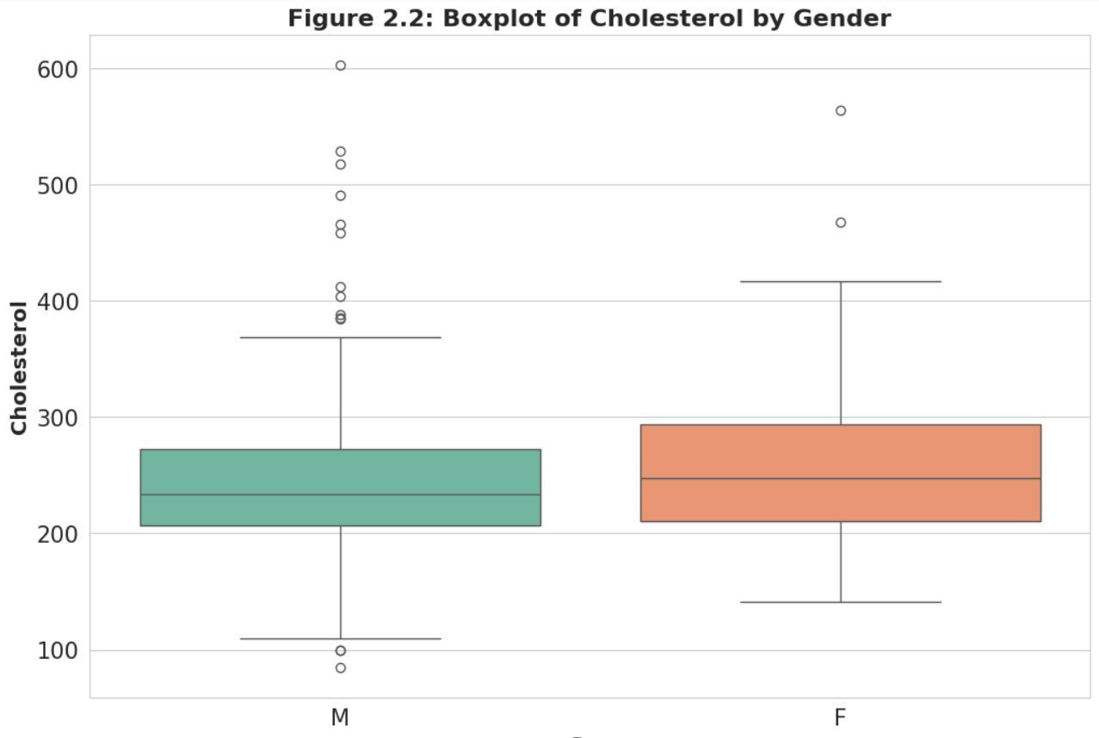
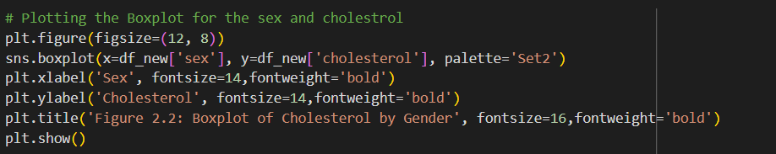
Box plot of Cholesterol by Sex
Figure 2.2: Boxplot of Cholesterol by Gender represents the distribution of cholesterol levels among different genders. This plot helps visualize the spread and central tendency of cholesterol levels across different sexes, allowing for comparison between the two groups.

Slide 13
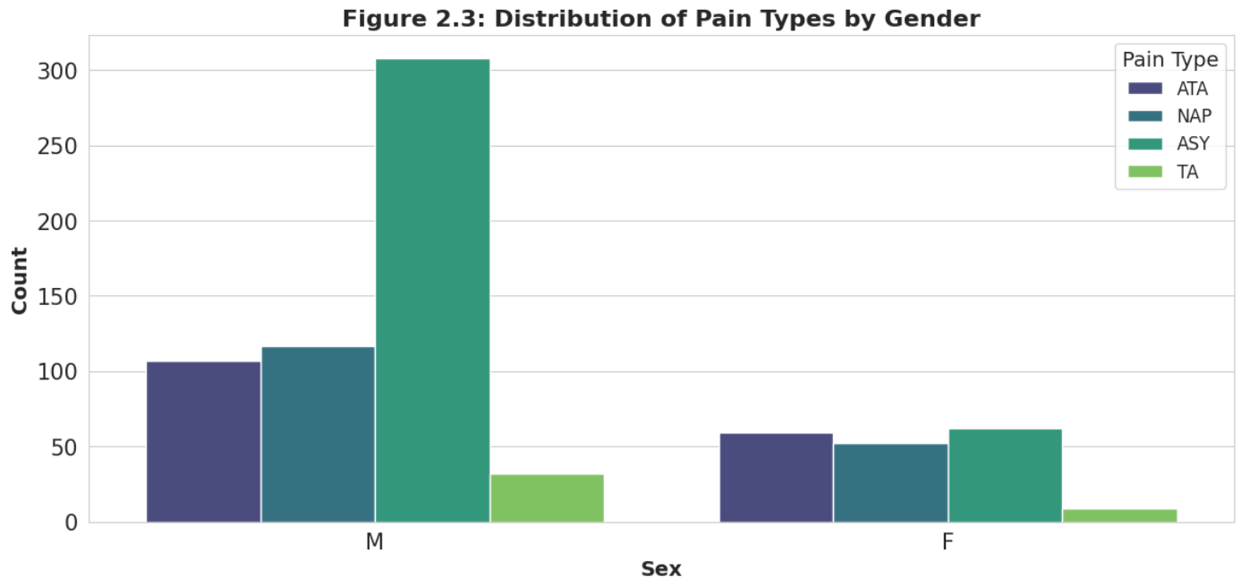
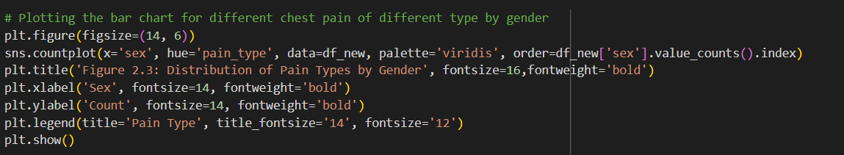
Bar chart for Pain type by Sex
The plot depicts a bar chart illustrating the distribution of different types of chest pain among different genders within the dataset.

Slide 14
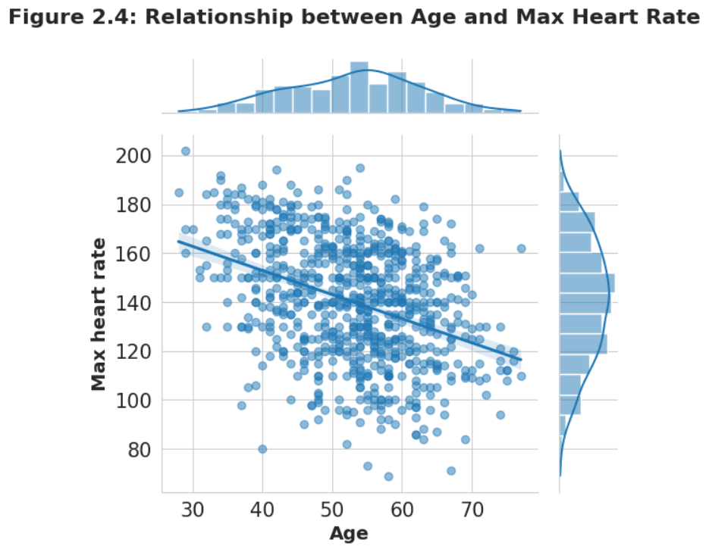
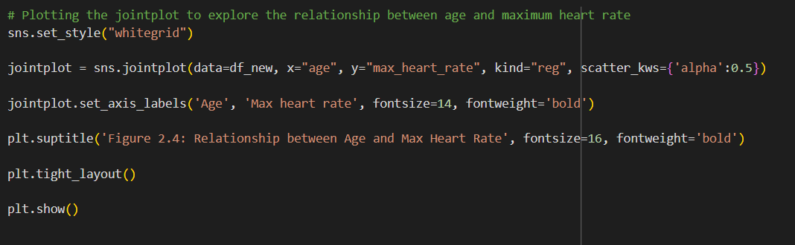
Scatter plot with histrogram for Age and Max Heart Rate
The joint plot includes scatter plots for each feature( Age and Max Heart Rate), histograms for each variable's distribution, and a regression line representing the relationship between the two variables.

Slide 15
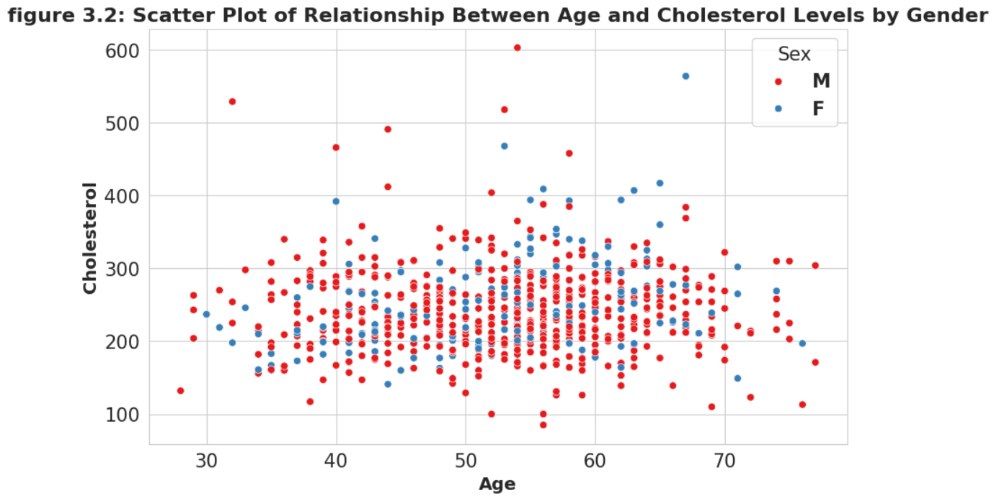
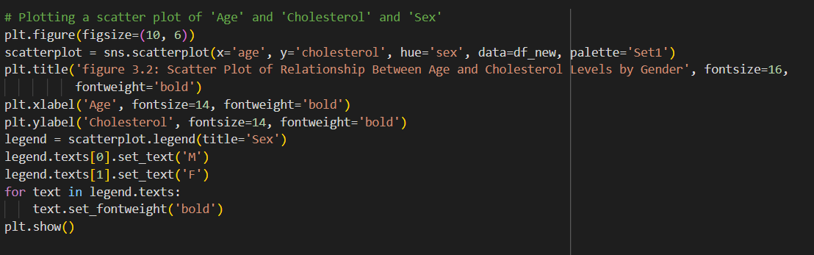
Scatter Plot of Age, Cholesterol and Sex
The scatter plot depicts the relationship between age and cholesterol levels, with gender distinguished by color. plot helps to visualize patterns or trends in age and cholesterol levels vary across genders.

Slide 16
Classifiers to predict the target feature:
Support Vector Machine(SVM)
Gradient Boosting Classifier
Random Forest Classifier
KNN Classifier
Logistic Regression

Slide 17
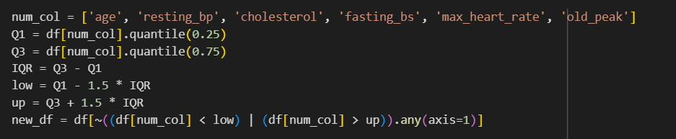
Outlier Removal
The basic requirement for testing the model's performance is that it should be free of outliers to ensure accurate results. Here, we used a basic technique for outlier removal by calculating the interquartile range (IQR), defined as the difference between the third quartile (Q3, 0.75) and the first quartile (Q1, 0.25). Specifically, IQR = Q3 - Q1.

Slide 18
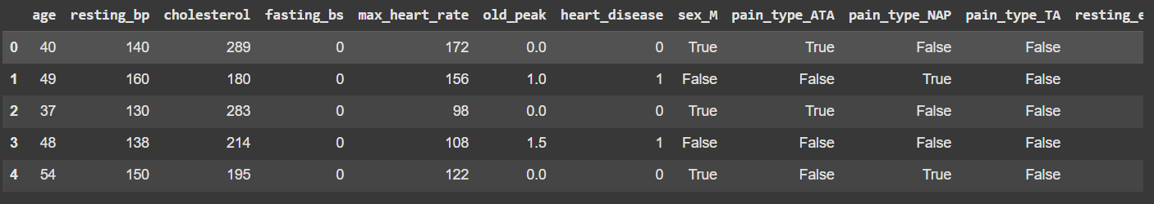
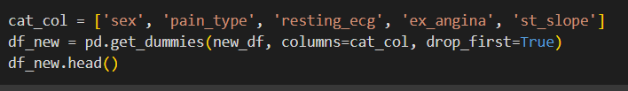
Predictive Modelling
The primary requirement for a machine learning model is that it can only process numerical values, not categorical data. Therefore, it is necessary to perform one-hot encoding to convert categorical features into binary values. This ensures that each category has a distinct representation, enabling the algorithm to make accurate predictions. This transformation can be achieved using the get_dummies function from the pandas library.

Slide 19

Target Variable Encoding
The target variable, also known as the dependent variable in the dataset, is used to measure metrics such as accuracy, precision, recall, and F1 score. It represents the outcome that the model predicts. Therefore, we store it separately from the other features to facilitate accurate predictions.

Slide 20
Splitting Data in Train and Test
we split the data into training and testing sets to evaluate the model's performance on new, unseen data. Here, the 'test_size" is set to 0.3, which means 30% of the data is used for testing and 70% for training. The 'random_state', set to 66, specifies the random seed value used to ensure reproducibility of the data splitting process

Slide 21

Feature Scaling
Feature scaling is necessary because features often have numerical values measured on different scales, which can adversely affect the model's performance. To avoid any misleading influences from features with larger numerical ranges, we need to scale them to a certain level.

Slide 22

Feature Selection
We have selected the 9 features because limiting the features will help simplify the model and make it less prone to overfitting. By focusing on the top 9 features, it will be easier to determine which number of features works best with each classifier. We used the Chi-Square test to evaluate the independence of the features with respect to the target variable.

Slide 23
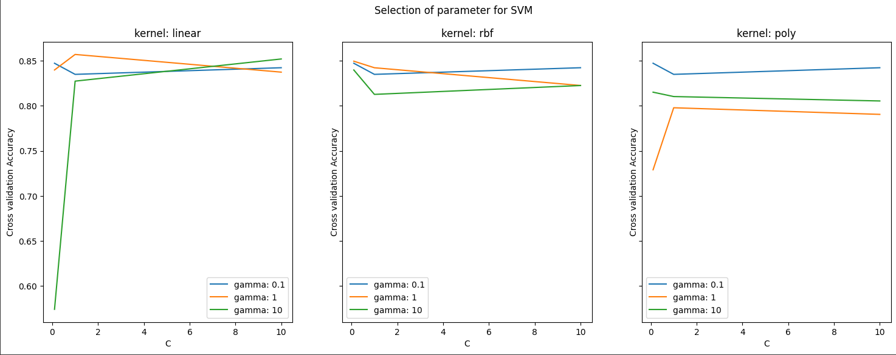
Model 1 – Support vector Machine
Best parameters: {'C': 1, 'gamma': 0.1, 'kernel': 'rbf’}
Cross-validation accuracy score for 5 folds: 0.8571815718157183

Slide 24
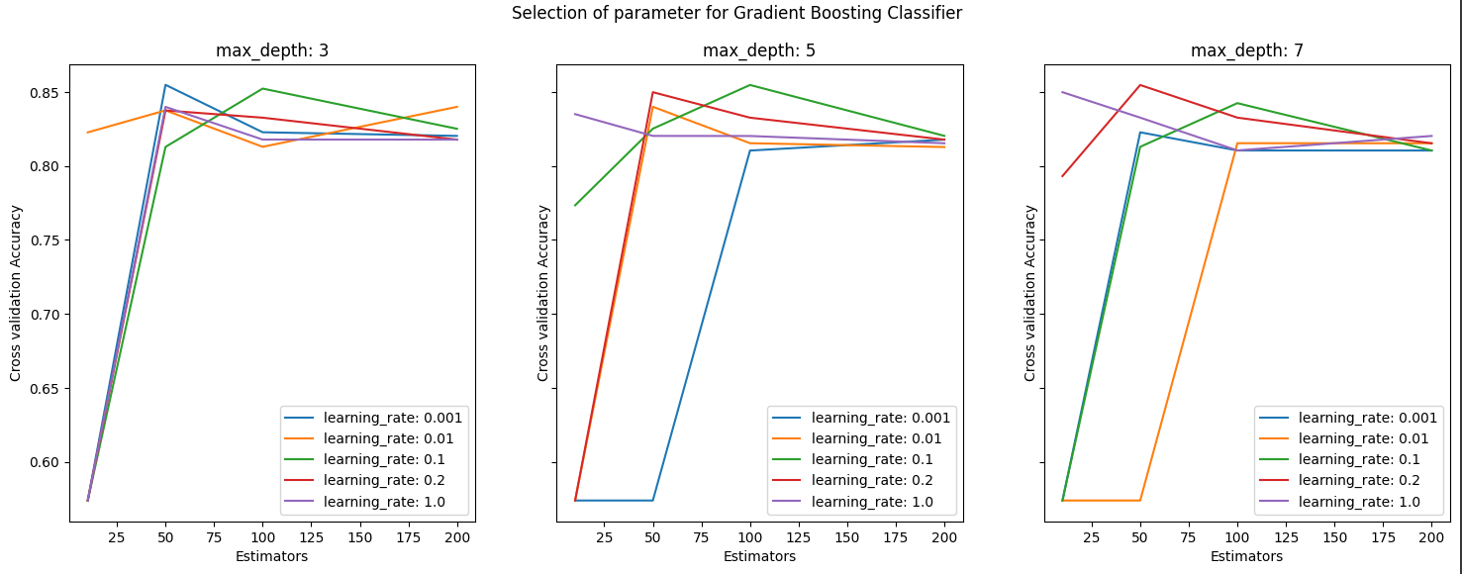
Gradient Boosting Classifier
Best parameters: {'learning_rate': 0.01, 'max_depth': 3, 'n_estimators': 200}
Cross-validation accuracy score for 5 folds: 0.8547726588376996

Slide 25
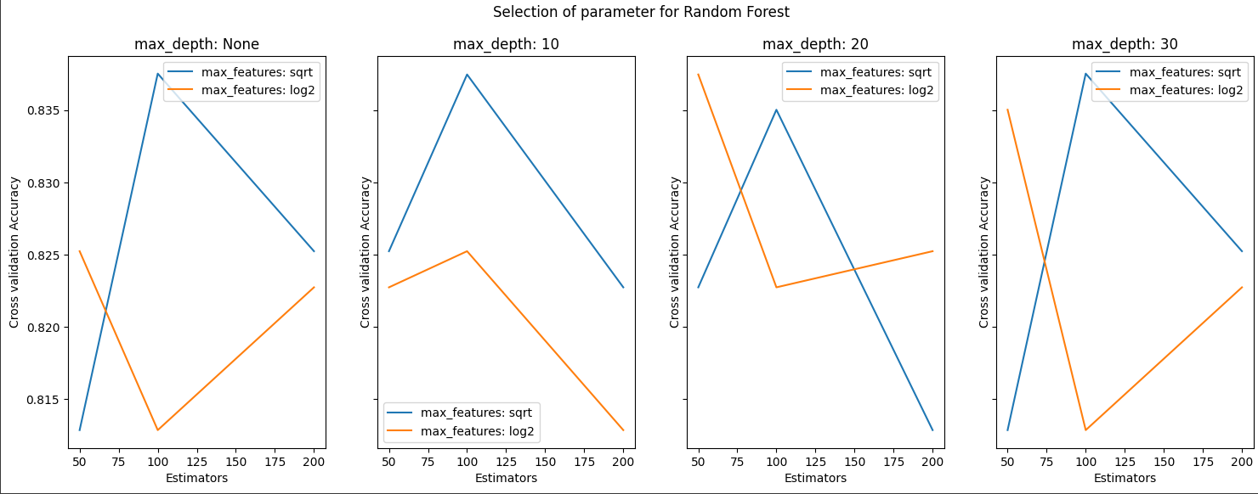
Random Forest Classifier
Best parameters: {'max_depth': 10, 'max_features': 'sqrt', 'n_estimators': 200}
Cross-validation accuracy score for 5 folds: 0.8375188196326407

Slide 26
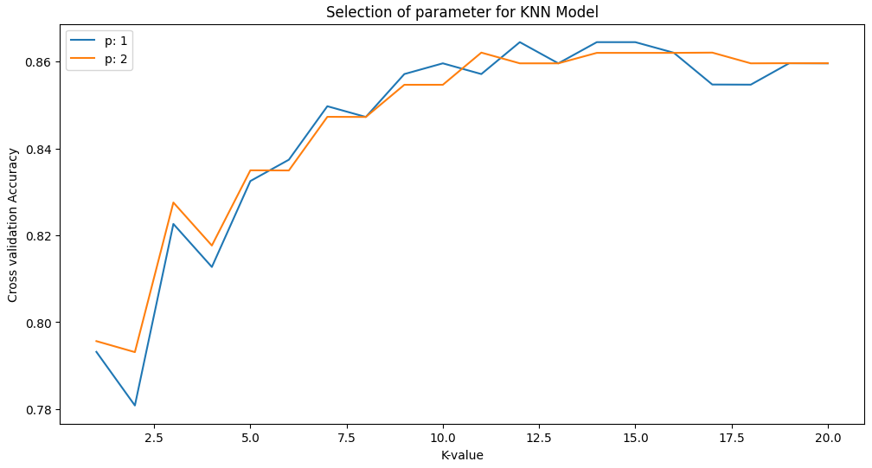
KNN Classifier
Best parameters found: {'n_neighbors': 12, 'p': 1}
Best cross-validation accuracy score: 0.8644685335742247

Slide 27
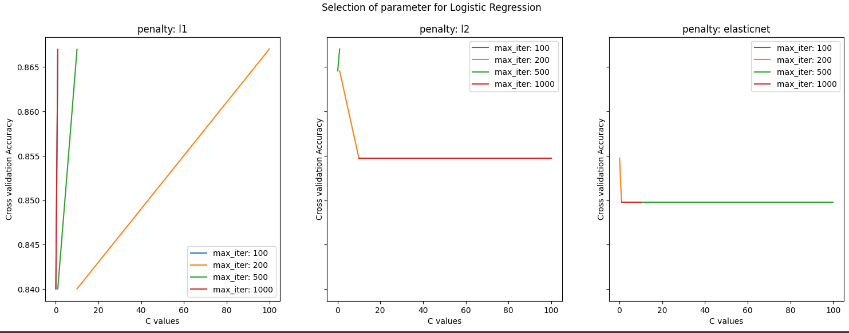
Logistic Regression
Best parameters found: {'C': 1, 'max_iter': 100, 'penalty': 'l2’}
Best cross-validation accuracy score: 0.8670280036133693

Slide 28
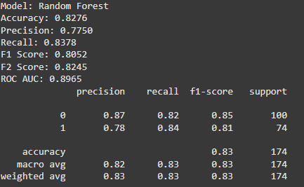
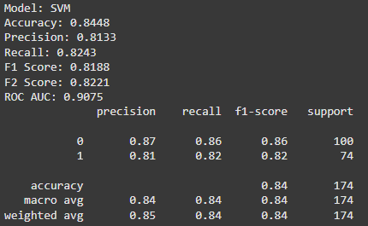
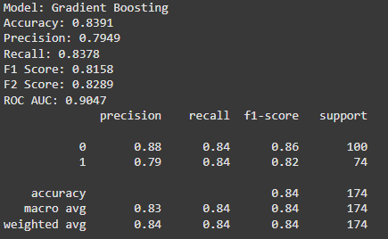
Model Evaluation
1.
2.
3.

Slide 29
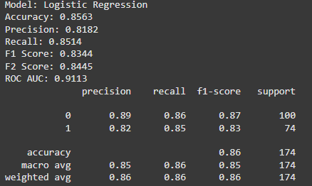
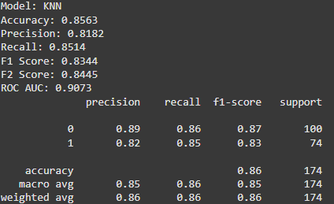
4.
5.

Slide 30
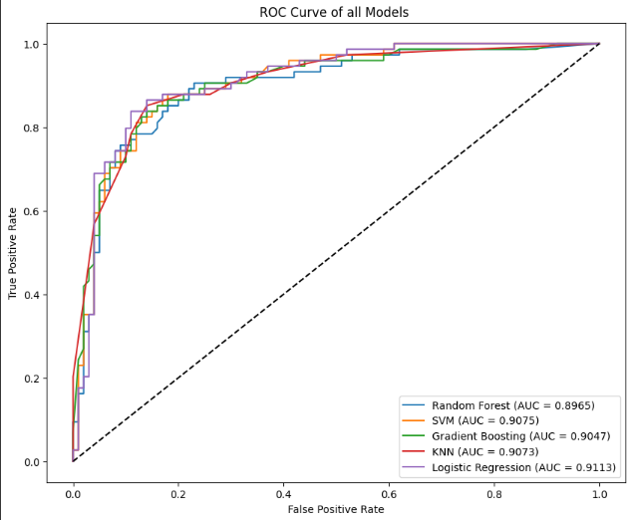
ROC Curve for all Models

Slide 31

Project By:
Adam Irfan
Neela
Piyush
Sathvika

